Slide 1
Object Oriented Software Engineering (OOSE)
22CS017
Unified Modelling Language (UML)
Lecture (Theory)
Prepared By Dr. Dinesh Vij

Slide 2
Index
Introduction to UML
Goals of UML
Characteristics of UML
UML Building Blocks
UML Modelling Software
Introduction to Use Case Diagram
Practice Questions

Slide 3
Introduction to UML
UML (Unified Modeling Language) is a general-purpose, graphical modeling language in the field of Software Engineering.
UML diagrams serve to describe, analyze, and test a system’s characteristics, behaviors, and other features.
It was initially developed by Grady Booch, Ivar Jacobson, and James Rumbaugh in 1994-95 at Rational software.
In 1997, it got adopted as a standard by the Object Management Group.

Slide 4
Goals of UML
Provide users with a ready-to-use, expressive visual modeling language so they can develop and exchange meaningful models.
Provide extensibility and specialization mechanisms to extend the core concepts.
Be independent of particular programming languages and development processes.
Provide a formal basis for understanding the modeling language.
Support higher-level development concepts such as collaborations, frameworks, patterns and components.

Slide 5
Characteristics of UML
It is a generalized modeling language.
It is distinct from other programming languages like C++, Python, etc.
It is interrelated to object-oriented analysis and design.
It is used to visualize the workflow of the system.
It is a pictorial language, used to generate powerful modeling artifacts.

Slide 6
UML Building Blocks
UML is composed of three main building blocks, i.e., things, relationships, and diagrams.
Building blocks generate one complete UML model diagram by rotating around several different blocks.
The basic UML building blocks are enlisted below:
Things
Relationships
Diagrams

Slide 7
Things
Things are the most important building blocks of UML. Things can be −
Structural
Behavioral
Grouping
Annotational

Slide 8
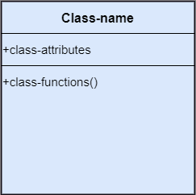
Things (contd.)
1. Structural Things:
They depict the static behavior of a model and display the physical and conceptual components.
They include class, object, interface, node, collaboration, component, and a use case.
Class: A Class is a set of identical things that outlines the functionality and properties of an object. It also represents the abstract class whose functionalities are not defined. Its notation is as follows;

Slide 9
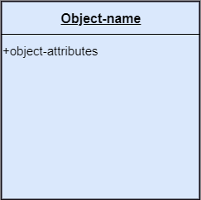
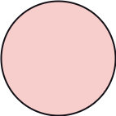
Things (contd.)
Object: An individual that describes the behavior and the functions of a system. The notation of the object is similar to that of the class; the only difference is that the object name is always underlined and its notation is given below;
Interface: A set of operations that describes the functionality of a class.

Slide 10
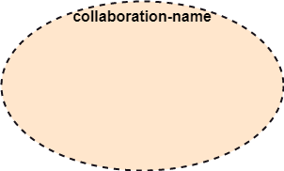
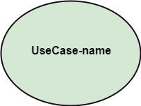
Things (contd.)
Collaboration: It represents the interaction between things that is done to meet the goal. It is symbolized as a dotted ellipse with its name written inside it.
Use case: Use case is the core concept of object-oriented modeling. It portrays a set of actions executed by a system to achieve the goal.

Slide 11
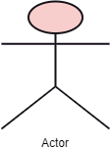
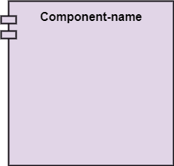
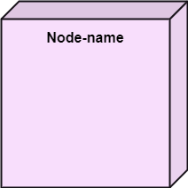
Things (contd.)
Actor: It comes under the use case diagrams. It is an object that interacts with the system, for example, a user.
Node: A physical element that exists. E.g., server, printer, etc.
Component: It represents the physical part of the system that reside on the node.

Slide 12
Things (contd.)
2. Behavioral Things:
Behavioral things are the dynamic parts of UML models.
In all, there are three primary kinds of behavioral things:
Interaction
State Machine
Activity

Slide 13
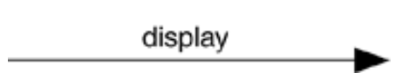
Things (contd.)
Interaction:
It is a behavior that comprises a set of messages exchanged among a set of objects or roles within a particular context to accomplish a specific purpose.
An interaction involves a number of other elements, including messages, actions, and connectors (the connection between objects).
Graphically, a message is rendered as a directed line, almost always including the name of its operation, as shown below

Slide 14
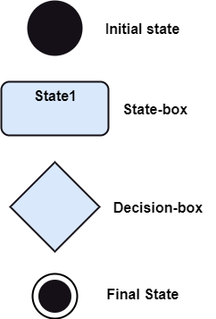
Things (contd.)
State Machine
It is a behavior that specifies the sequences of states an object or an interaction goes through during its lifetime in response to events, together with its responses to those events.
A state machine involves a number of other elements, including states, transitions (the flow from state to state), events (things that trigger a transition), and activities (the response to a transition).
Graphically, a state is rendered as a rounded rectangle, usually including its name and its substates, if any.

Slide 15
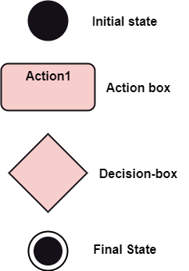
Things (contd.)
Activity
It is a behavior that specifies the sequence of steps a computational process performs.
In an interaction, the focus is on the set of objects that interact. In a state machine, the focus is on the life cycle of one object at a time. In an activity, the focus is on the flows among steps without regard to which object performs each step.
A step of an activity is called an action.
Graphically, an action is rendered as a rounded rectangle with a name indicating its purpose.
States and actions are distinguished by their different contexts.

Slide 16
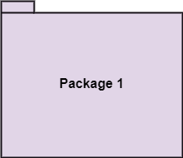
Things (contd.)
3. Grouping Things:
It is a method that together binds the elements of the UML model
There is one primary kind of grouping thing, namely, packages.
A package is a general-purpose mechanism for organizing the design itself, as opposed to classes, which organize implementation constructs. Structural things, behavioral things, and even other grouping things may be placed in a package.
Unlike components (which exist at run time), a package is purely conceptual (meaning that it exists only at development time).
Graphically, a package is rendered as a tabbed folder, usually including only its name and, sometimes, its contents

Slide 17
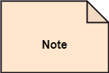
Things (contd.)
4. Annotational Things:
Annotational things are the explanatory parts of UML models.
These are the comments you may apply to describe, illuminate, and remark about any element in a model.
There is one primary kind of annotational thing, called a note.
A note is simply a symbol for rendering constraints and comments attached to an element or a collection of elements.
Graphically, a note is rendered as a rectangle with a dog-eared corner, together with a textual or graphical comment.

Slide 18

Relationships
It illustrates the meaningful connections between things. There are four types of relationships given below:
Dependency
Association
Generalization
Realization
1. Dependency: It is a semantic relationship between two model elements in which a change to one element (the independent one) may affect the semantics of the other element (the dependent one). Graphically, a dependency is rendered as a dashed line, possibly directed, and occasionally including a label

Slide 19
Relationships (contd.)
2. Association:
It is a structural relationship among classes that describes a set of links, a link being a connection among objects that are instances of the classes.
E.g.: city bus and riders.
Aggregation is a special kind of association, representing a structural relationship between a whole and its parts. E.g., shirt and pockets
Graphically, an association is rendered as a solid line or it is denoted by a dotted line with arrowheads on both sides to describe the relationship with the element on both sides.

Slide 20

Relationships (contd.)
3. Generalization
It is a specialization/generalization relationship in which the specialized element (the child) builds on the specification of the generalized element (the parent).
The child shares the structure and the behavior of the parent.
E.g. vehicle is a bus, car, truck.
Graphically, a generalization relationship is rendered as a solid line with a hollow arrowhead pointing to the parent

Slide 21

Relationships (contd.)
4. Realization
It is a semantic relationship between classifiers, wherein one classifier specifies a contract that another classifier guarantees to carry out.
You'll encounter realization relationships in these places:
between interfaces and the classes or components that realize them, and
between use cases and the collaborations that realize them.
Graphically, a realization relationship is rendered as a cross between a generalization and a dependency relationship

Slide 22
UML Modelling Software
"UML Modelling Software" refers to a computer program that allows users to create visual diagrams using the Unified Modeling Language (UML), a standardized way to represent the structure and behavior of a software system.
Essentially acting like a "blueprint" for designing software applications by visually depicting different components and their relationships through various types of diagrams.
UML itself is not a programming language but a standardized notation, meaning different UML modeling tools can interpret and display the diagrams in a consistent manner.
Examples of popular UML modeling software:
Visual Paradigm, Microsoft Visio, Lucidchart, StarUML, and Enterprise Architect.

Slide 23
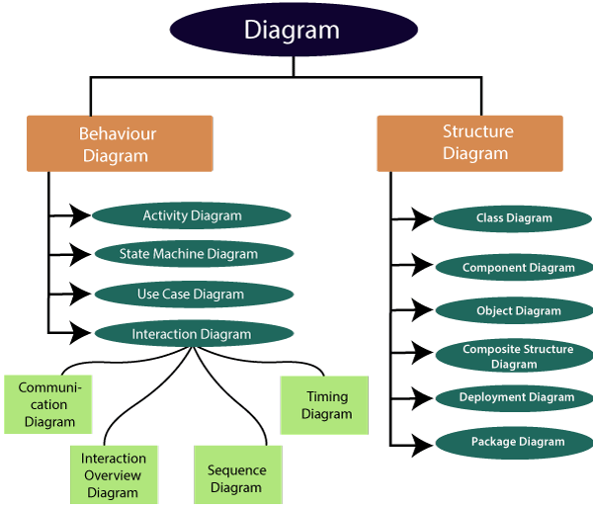
Diagrams in UML
Figure 1: Types of Diagrams

Slide 24
Introduction to Use Case Diagram
What are Use Cases?
In software and systems engineering, a use case is a list of actions or event steps, typically defining the interactions between a role (known in the Unified Modeling Language as an actor) and a system, to achieve a goal.
The actor can be a human or an external system.
A use case describes a way in which a real-world actor interacts with the system.

Slide 25
Importance of Use Case
Use cases have been used extensively over the past few decades.
The advantages of Use cases include:
The list of goal names provides the shortest summary of what the system will offer.
It gives an overview of the roles of each and every component in the system. It will help us in defining the role of users, administrators, etc.

Slide 26
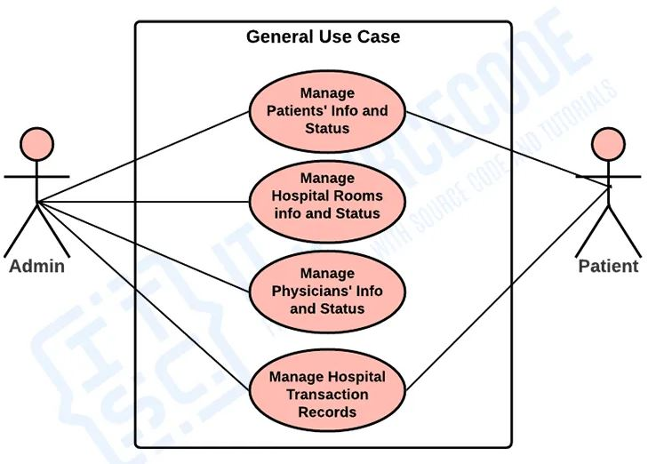
Contd…
The features of the system depends on the users of it.
General use case
Figure 2: General Use case diagram of Hospital Management System

Slide 27
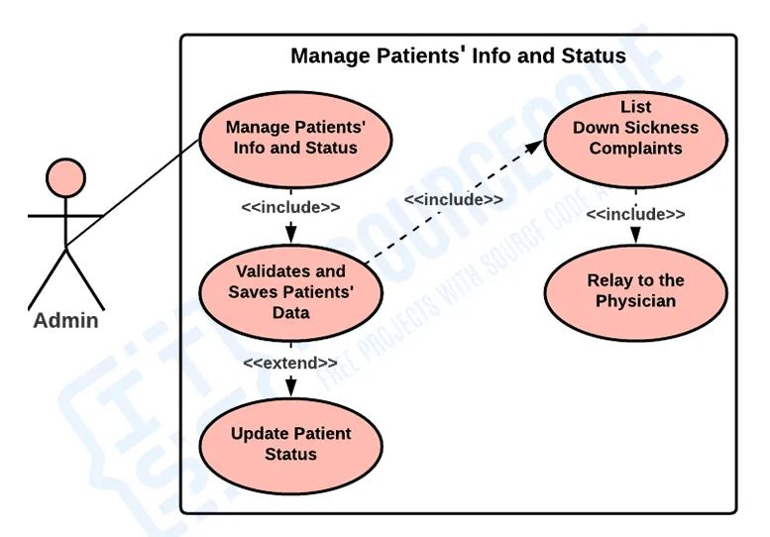
Contd…
Monitor and Manage Patients’ Information and Status
Figure 3. Use case diagram of Monitor and Manage Patients’ Information and Status

Slide 28
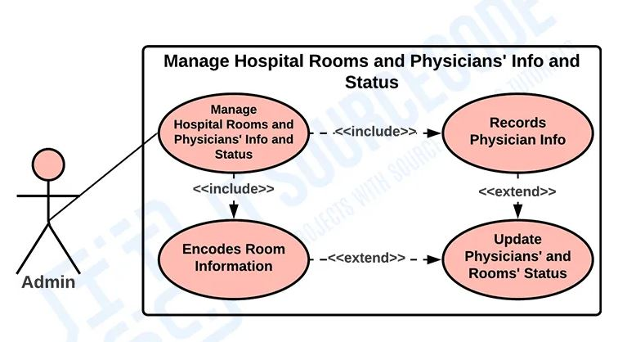
Contd…
Manage Hospital Rooms and Physicians’ Info and Status
Figure 4. Use case diagram of Manage Hospital Rooms and Physicians’ Info and Status

Slide 29
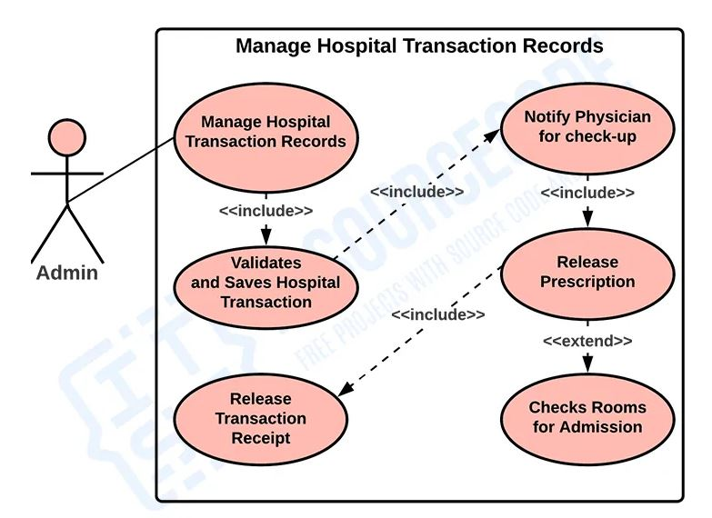
Contd…
Monitor Hospital Transaction Records
Figure 5. Use case diagram of Monitor Hospital Transaction Records

Slide 30
Practice Questions
What is a UML diagram stereotype, and how is it used?
How is inheritance represented in UML?
Can you explain use case diagrams?
Can you explain 'Extend' and 'Include' in use cases?
What do you mean by structure diagram?

Slide 31
THANKS

